Slide 1
1/8
An Implementation for solving Motif Finding Problem
Under the guidance of Prof. V. Milutinovic
Presenter - Jayendra Khandare
(jkhandar@umail.iu.edu)

Slide 2
2/8
Motif Finding Problem[1]
Goal : Given a set of DNA sequences, find a set of L-mers, one from each sequence, that maximizes the consensus score.
Input : A t x n matrix of DNA sequences, and l, the length of the pattern to find
Output : An array of t starting positions
s = (s₁, s₂, … s_{t}) maximizing Score(s,DNA)

Slide 3
Platform : Maxeler Systems
3/8
Maxeler develops hardware, software and provides other services which help to gain performance per unit of rack space.[2]
It also helps bringing down the power bill.
It is based on data-flow computing,
  Which focuses on optimizing the movement of data.
  Utilizes massive parallelism between 1000s of tiny cores
It has this concept of ‘skins’ which helps to implement the code using various languages like :
  Python
  R
  Matlab
  C

Slide 4
Implementation Details
4/8
initialize( ) uses random number generator
  provided by <stdlib.h> to create 5 DNA strands.
printDNAs( ) simply prints the DNAs generated.
CPU( ) method executes as per control-flow model.
DFE( ) method executes the data-flow model.
In both of these methods :
  First, profile matrix(matrices) are calculated.
  Second, location is calculated for which score(s,DNA) is maximum.
  Lastly, based on the location, consensus is calculated.
Outputs are compared and decided, if implementation was successful.
Finally, total number of stop-codons[3] is counted and displayed.

Slide 5
Requirements for Acceleration
5/8
There are 6 requirements for a loop to be ported to data-flow model. [4]
The chosen loop satisfies some of the requirements.
There are 5 loops which can be remodeled to be one.
It contributes significantly to the execution time.
It executes for every entry in the DNA sequences.
It has to deal with huge data i.e. 5 DNA strands.
  Total data = 5 * sizeOfDNA (by default : 5 * 1048576)

Slide 6
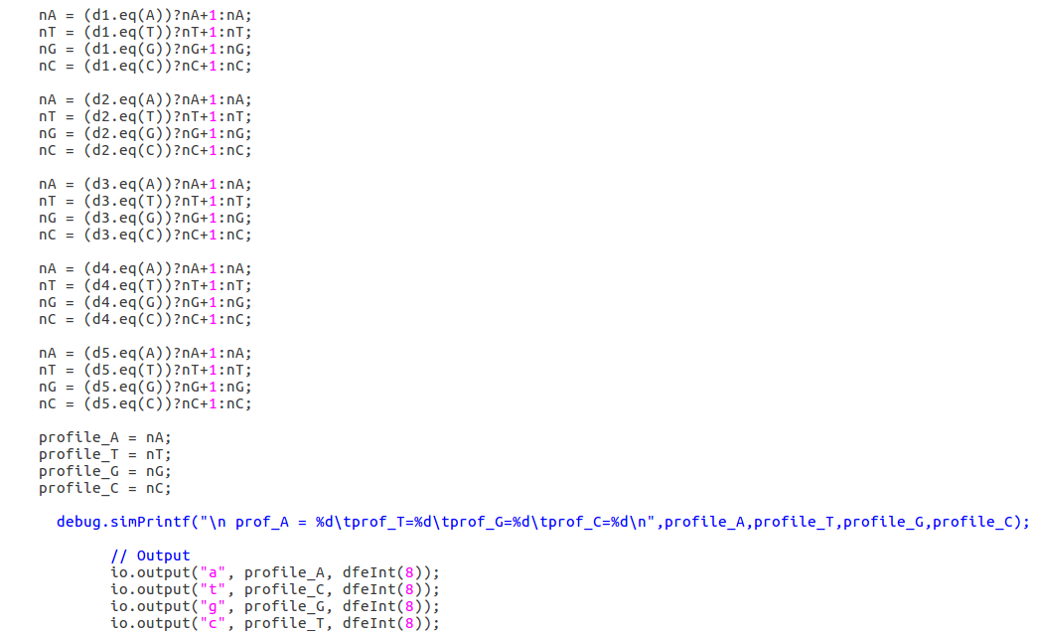
Excerpt from EngineCode
6/8
Calculating total numbers of As,Ts,Gs, and Cs
Assigning values to output streams
Output streams

Slide 7
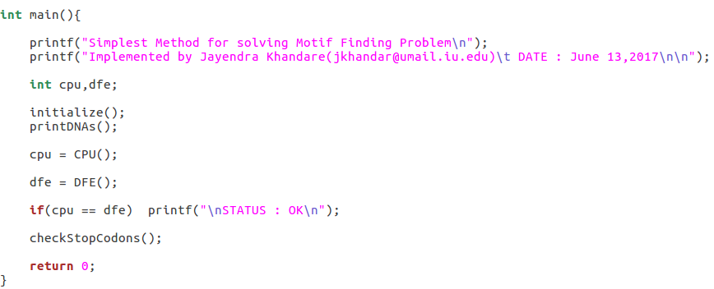
CPUCode
7/8
Creating random DNA strands
Calling CPU( ) method
Calling DFE( ) method
STATUS
Checking for stop-codons

Slide 8
References
8/8
An Introduction to Bioinformatics Algorithms [page 98]
  by Neil C. Jones and Pavel A. Pevzner
Information about Maxeler Technologies given at
  http://www.maxeler.com/
Stop-codons
  (triplets which signify the end of DNA sequences)
  https://en.wikipedia.org/wiki/Stop_codon
Instructions provided by Prof. V. Milutinovic
  for porting a loop into data-flow system.
  http://home.etf.rs/~vm/os/vlsi/predavanja/maxeler.html

